Slide 1


Slide 2

Name: | Noman Shahid
Roll no: | 22P-9029
Class: | 2A
Section: | BS - CS
Subject: | Communication and Presentation Skills-Lab
Presentation | Final

Slide 3
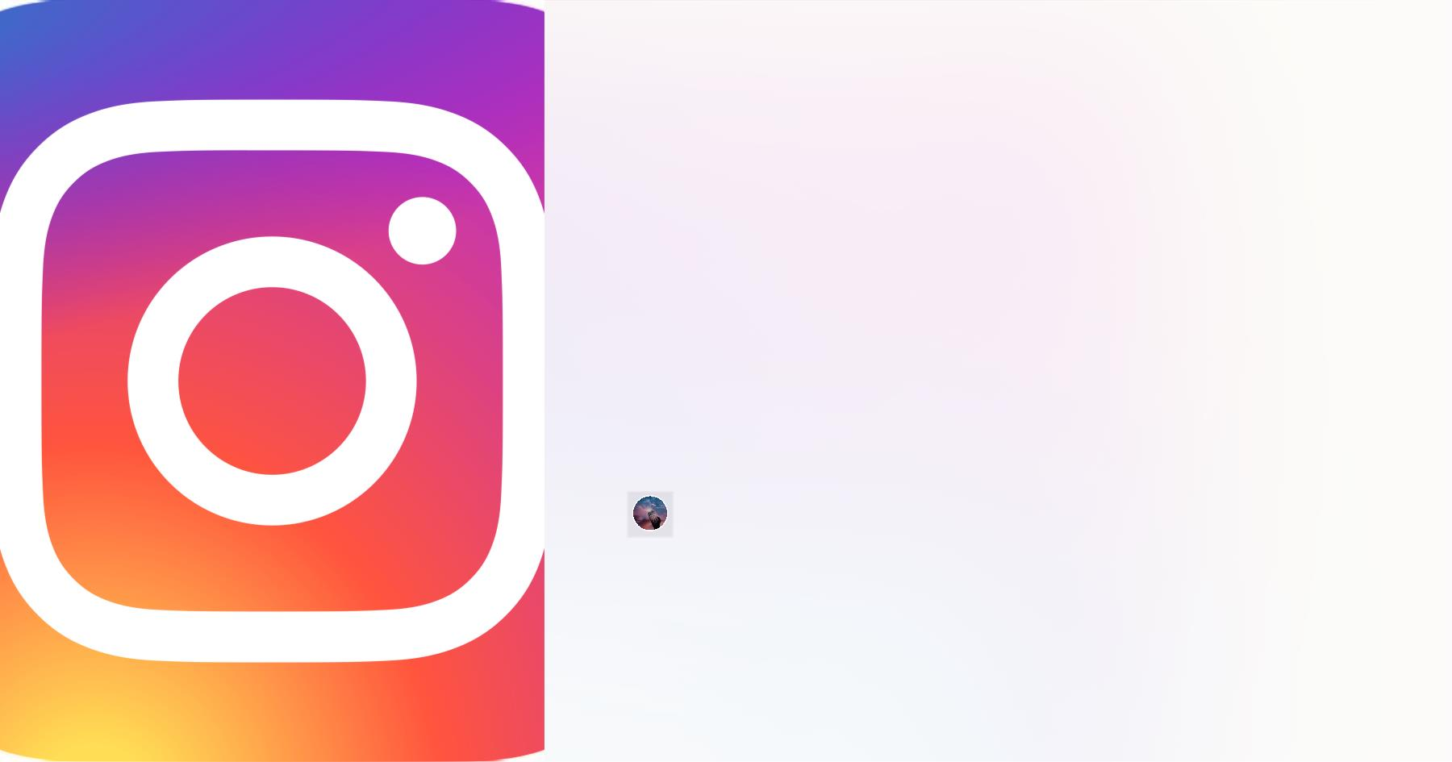
Instagram
Welcome to the world of Instagram, the photo and video sharing app that has
taken social media by storm. Follow along as we take a deep dive into
everything you need to know to become an expert on this platform.

Slide 4

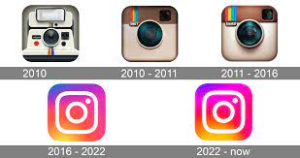
History of Instagram
1
2
3
The Beginnings
Growth and Acquisitions
Today
Instagram was created in 2010
by Kevin Systrom and Mike
Krieger as a photo-sharing app
for the iPhone.
By 2012, Instagram had
surpassed 100 million users and
was sold to Facebook for $1
billion. Since then, it has
continued to add new features
and grow in popularity around
the world.
With over 1 billion active users,
Instagram has become one of
the most widely used social
media platforms with a broad
range of uses for businesses
and individuals alike.

Slide 5

Welcome to Instagram!
Follow Friends & Family
Discover New Accounts
Start by following your friends and f amily members
to see what they're up to and stay connected.
Find new accounts to follow by using the
"Discover" tab to explore accounts based on your
preferences and interests.
Customize Your Experience
Enjoy and Engage
Make Instagram your own by selecting the accounts
you want to see f irst and customize your profile to
reflect your unique style.
Instagram is a place to have f un, be creative, and
engage with others. Share your passions, thoughts,
and ideas. Like and comment on other's posts and
watch your own community grow.

Slide 6
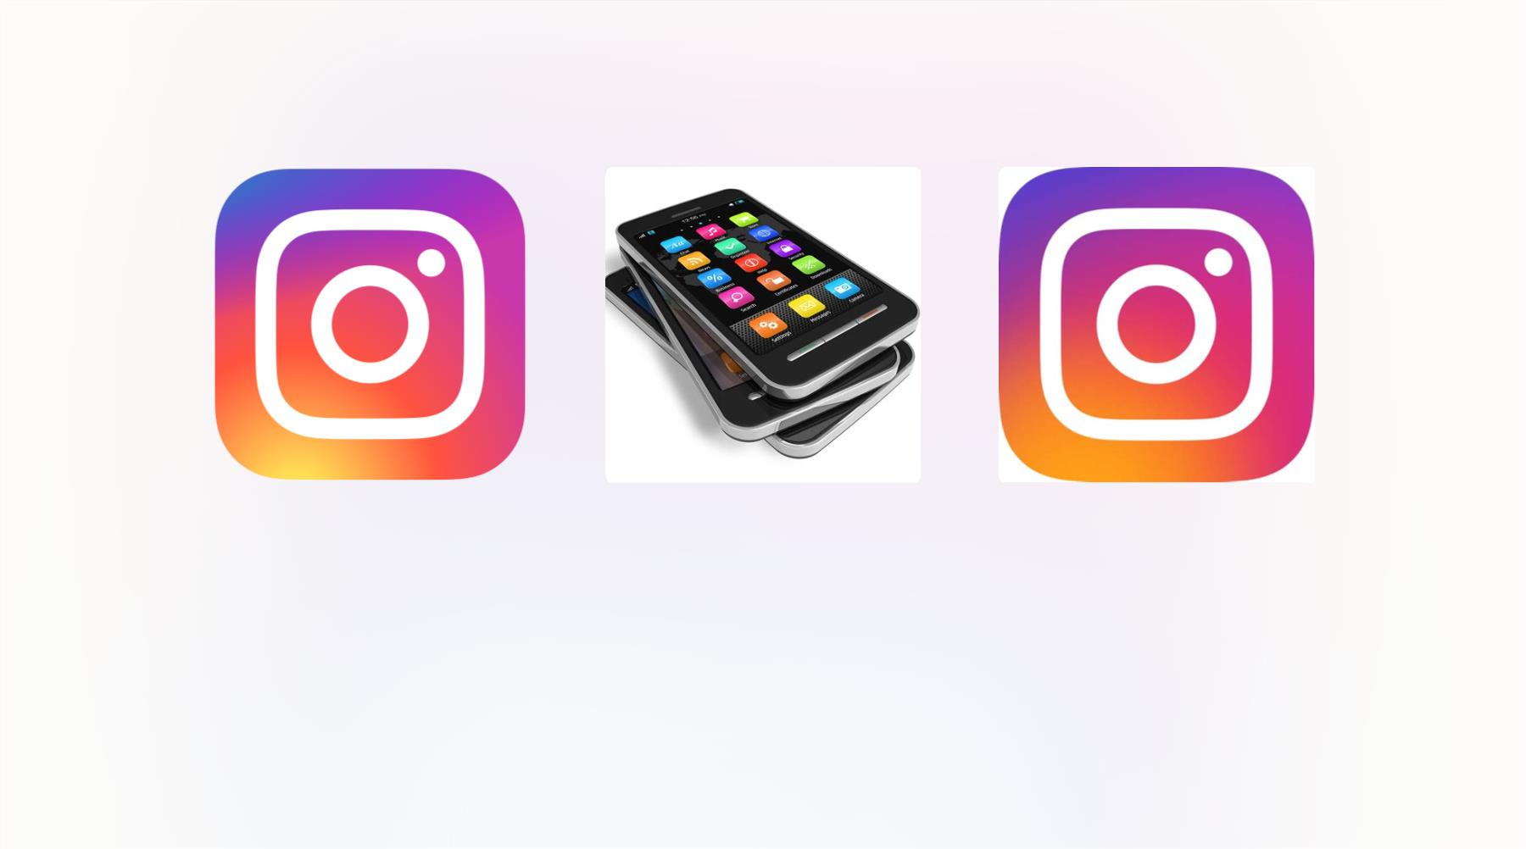
What is Instagram?
A Social Media Platform
An App for Mobile Devices
A Creative Platform
Instagram is a free photo and video
sharing app that allows users to
share their daily lives, interests, and
creative work with their followers.
The app is designed for mobile
devices, allowing users to capture
and share content from anywhere
and at any time.
From filters to editing tools,
Instagram provides users with a
creative platform for sharing their
work and expressing themselves in a
unique way.

Slide 7
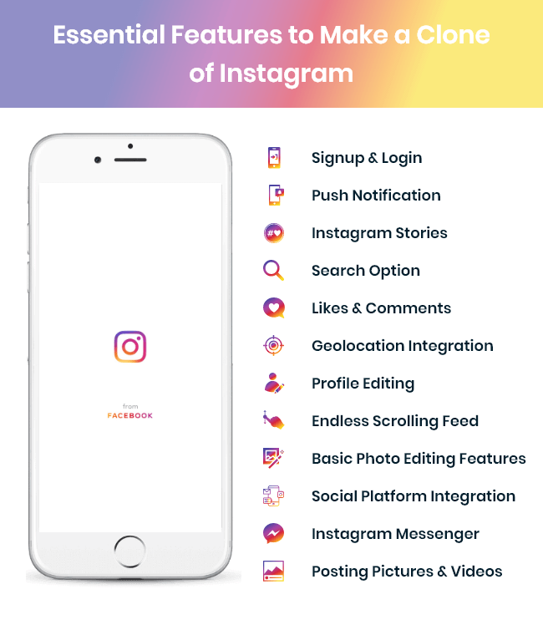

Features of Instagram
1 Feed
The main page where users see content from accounts they follow
and explore new content.
2 Stories
A f eature where users can share photos and videos that disappear
af ter 24 hours.
3
4
Explore Page
A way to f ind new content and accounts based on user's interests and
preferences.
Direct Messaging
A way to have private conversations with other users on the platform.

Slide 8

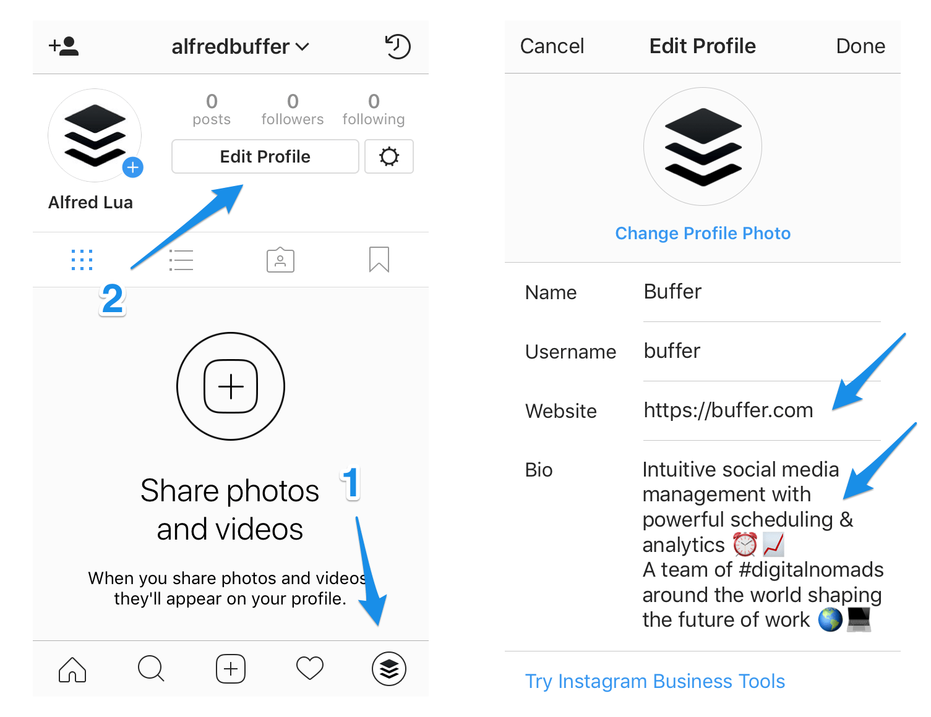
Profile Setup
1
2
3
Choose a Username
Select a unique username that reflects your
identity or the purpose of your account.
Profile Photo
Choose a profile photo that represents who you are or what your account is about.
Bio
Write a short bio that tells others about you or what your account is about. Use keywords related to your content to make your account more discoverable.

Slide 9

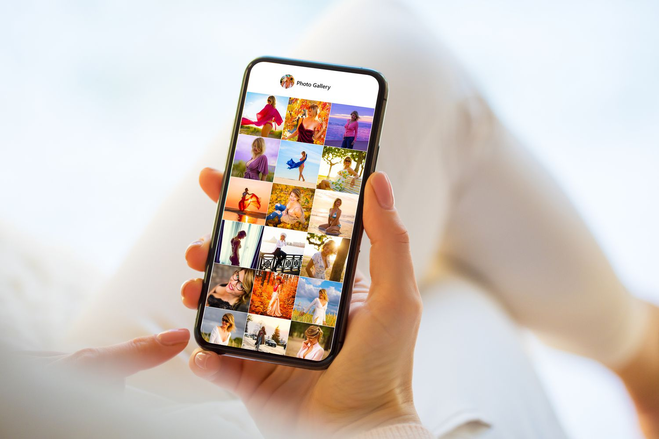
Uploading Photos
1
2
3
Select a Photo
Select a photo from your camera roll or take a new one
using the Instagram camera.
Edit the Photo
Use filters and editing tools to enhance your photo's appearance, or to give it a unique look and
feel.
Write Captions and Hashtags
Write captions that describe your photo and add hashtags to make your account more discoverable
to others.

Slide 10


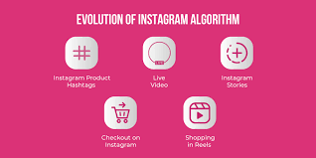
How Instagram Works
Followers & Following
The Algorithm
Engagement &
Interaction
Users can follow other accounts
to see their posts and updates in
their feed, and get followed by
other users who are interested in
their content. This creates a
network of accounts that are
linked together through shared
interests and content.
Instagram uses a complex
algorithm to determine what
content to display in users' feeds
and explore pages. It considers
many factors, including recency,
engagement, and relevance.
Instagram rewards accounts that
engage with others and create
interesting and usef ul content. By
commenting on other's posts,
interacting with followers in direct
messages, and using hashtags,
users can improve their reach and
grow their following.

Slide 11
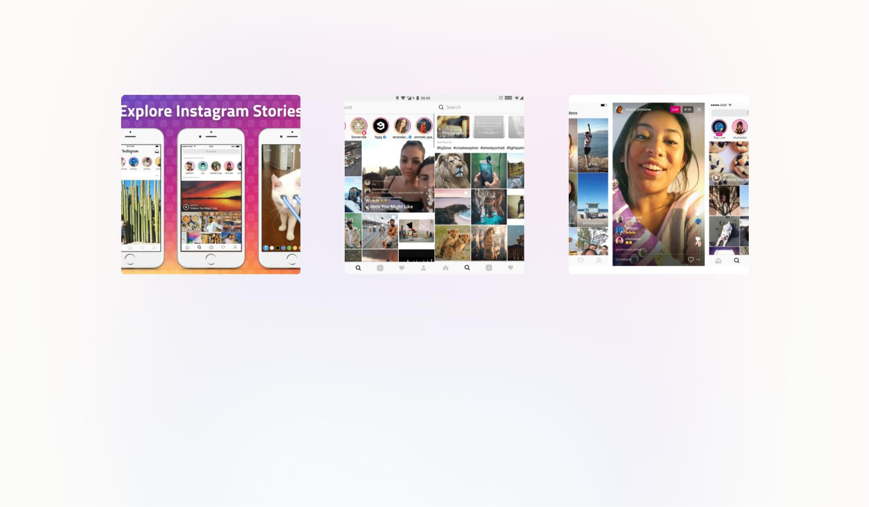
Stories, Explore Page, and Instagram Live
Stories
Explore Page
Instagram Live
Stories are photos and videos that
disappear af ter 24 hours. Users can
add stickers, filters, and text to their
The Explore page is a section of the
app that features content based on
user's interests, activity, and the
Instagram Live allows users to
broadcast live videos to their
followers and engage with them in
real-time. This f eature is great for
Q&A sessions, behind-the-scenes
content, or product launches.
Stories to make them more engaging accounts they f ollow. It's a great way
and interactive.
to f ind new content and accounts to
f ollow.

Slide 12

Instagram for Business
Business Profile
Promote Posts
Create a business profile to make it easier for users
to f ind and engage with your brand.
Promote posts to reach new audiences and
increase engagement with existing ones.
Social Listening
Analytics
Use Instagram to monitor your brand's mentions
and engage with customers in real-time.
Use Instagram Analytics to gain insights into your
audience and the effectiveness of your content.

Slide 13



Privacy and Security
1 Protect Your Account
2 Report Inappropriate
Content
Use two-factor
authentication, limit third-
party app access, and
customize your privacy
settings to protect your
account from malicious
activity.
If you come across
inappropriate content on
Instagram, report it to the
platform's support team so
they can take appropriate
action.
3 Keep Personal Information Private
Avoid sharing sensitive or personal information on the platform that
could be used against you by hackers or malicious actors.

Slide 14


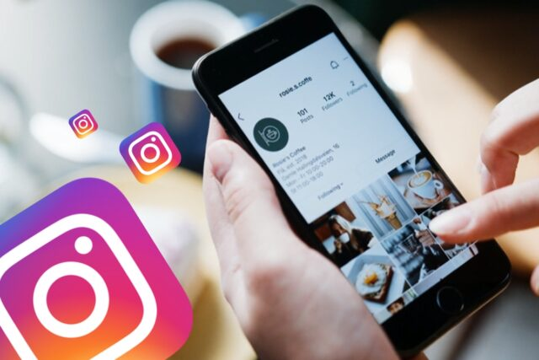
Advantages of Using Instagram
1
2
3
Brand Awareness
Engagement
Visual Storytelling
Instagram is a great place to
generate buzz and increase
brand awareness for your
business or personal brand.
Instagram offers a highly
engaged user base that is
interested in seeing and
Engaging with quality content.
With its emphasis on photos
and videos, Instagram is a
powerful platform for visual
storytelling and creative
expression.

Slide 15
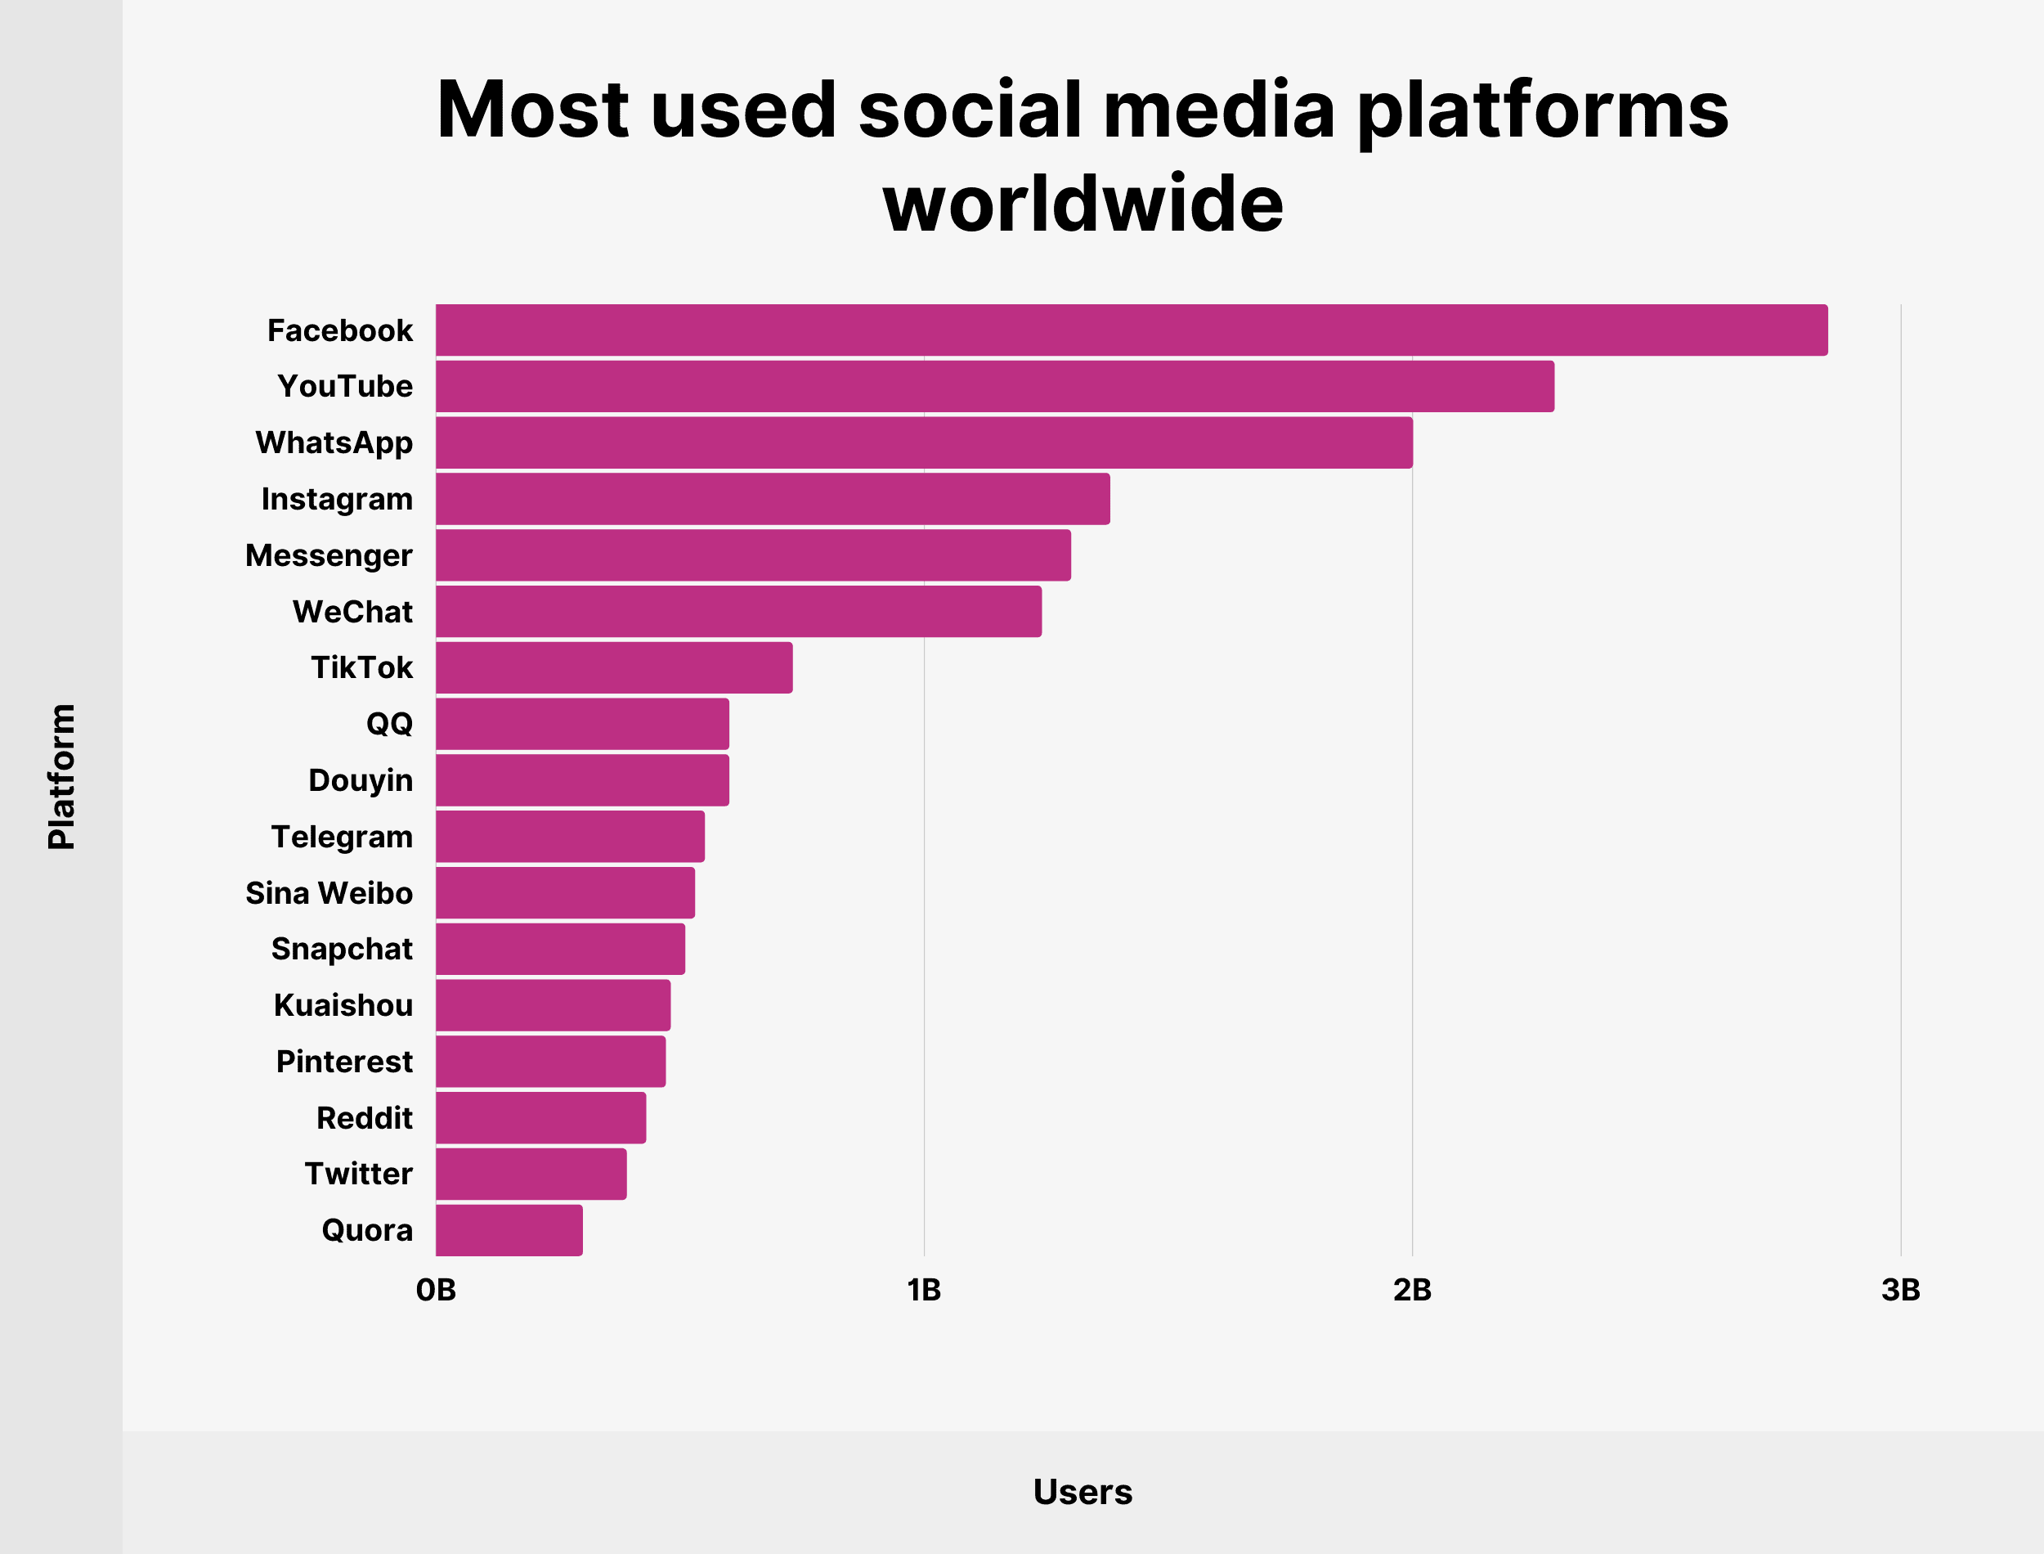
Statistics of Instagram Usage
User Demographics
Usage & Engagement
Instagram has more than 1 billion monthly active users,
with 500 million using the platform every day.
Instagram users spend an average of 28 minutes a day
on the platform, and the average person checks the
app more than 20 times a day.
71% of its users are under 35 years old, and more than
half of all users check the app daily.
Photos and videos receive on
average 23% more engagement
than other types of content on
theplatform.
90% of Instagram users follow at least one business
account on the platform.

Slide 16
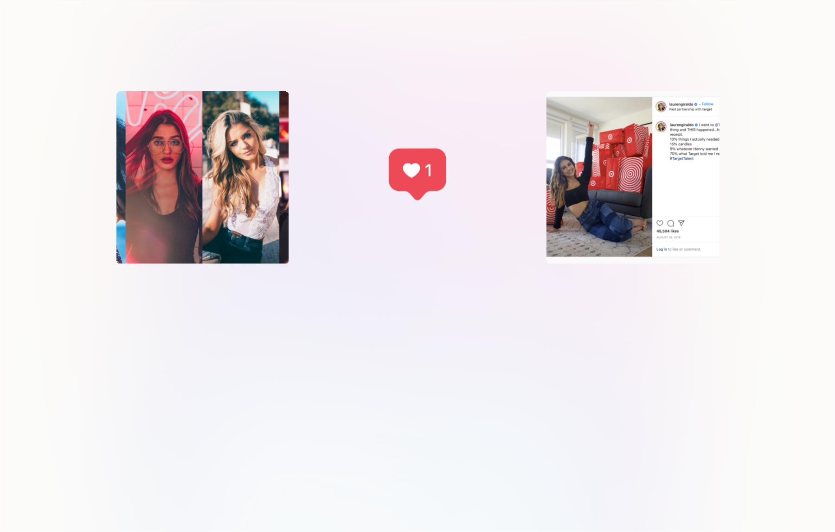
Influencer Marketing on Instagram
What is Influencer
Marketing?
The Power of Influencers
Successful Influencer
Campaigns
Influencers have the ability to reach
a large, engaged audience on
Instagram and make a signif icant
impact on a brand's visibility and
success.
Influencer marketing is a type of
marketing that involves partnering
with influencers (people who have a
large following on Instagram) to
promote products or services.
Some successful influencer
campaigns involve sponsored posts,
giveaways, takeovers, and product
placements. Brands that use creative
and authentic collaborations with
influencers tend to see the best
results.

Slide 17

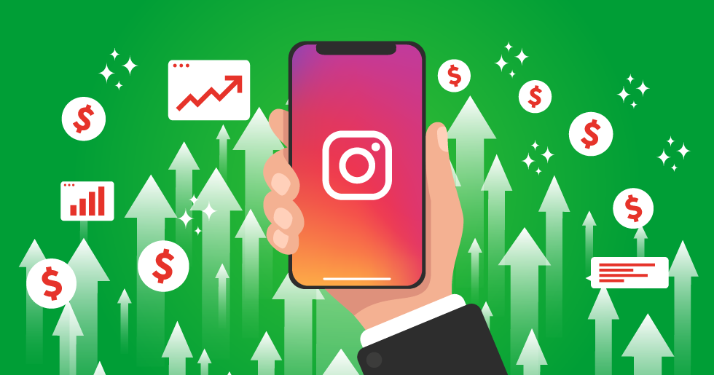
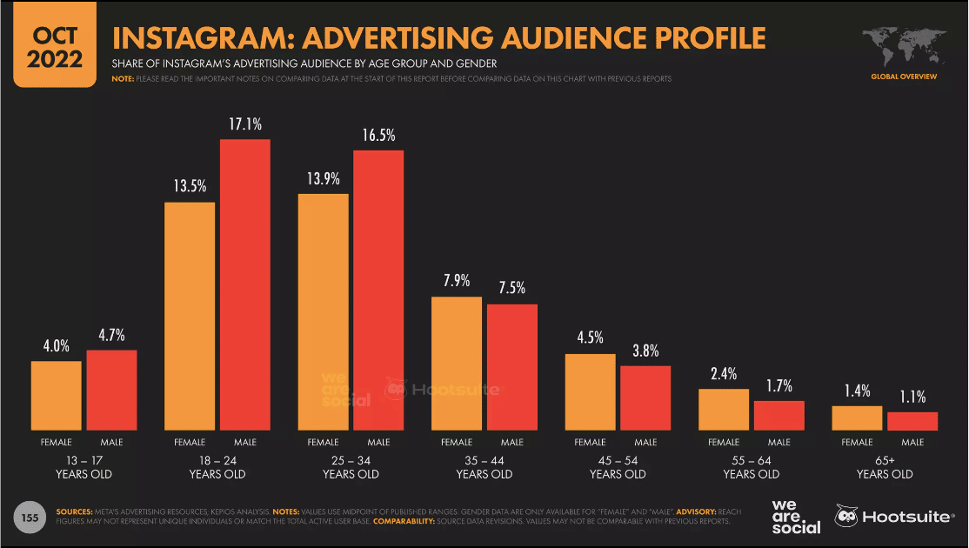
Tips for Using Instagram for
Business
1
Define Your Goals
Clearly def ine your goals and objectives for using Instagram, and
tailor your content and strategy to meet these goals.
2 Create Engaging Content
Create high-quality content that resonates with your audience, is
visually appealing, and is consistent with your brand identity and
message

Slide 18
Conclusion
Connect
Instagram is a powerful tool for connecting with people around the world and exploring different cultures and perspectives.
Create
Whether you're a business owner, influencer, or creator, Instagram provides endless opportunities for creativity and self-expression.
Grow
With its high engagement rates and broad reach, Instagram can help businesses and individuals grow their following and achieve their goals.

Slide 19


